Slide 1
The Intent of Offers
Intents Day 2023
Dean Tribble CEO Agoric OpCo

Slide 2
JavaScript Smart Contracts Use your existing language knowledge
Best-In-Class Component Model Framework for innovation across all skill levels
Integrated Economy Economic services & native IST stable token for fees to grow a rich economy
Unique Safety Properties Offer-safety, payout liveness, secure partitions
The General
Purpose Platform

Slide 3
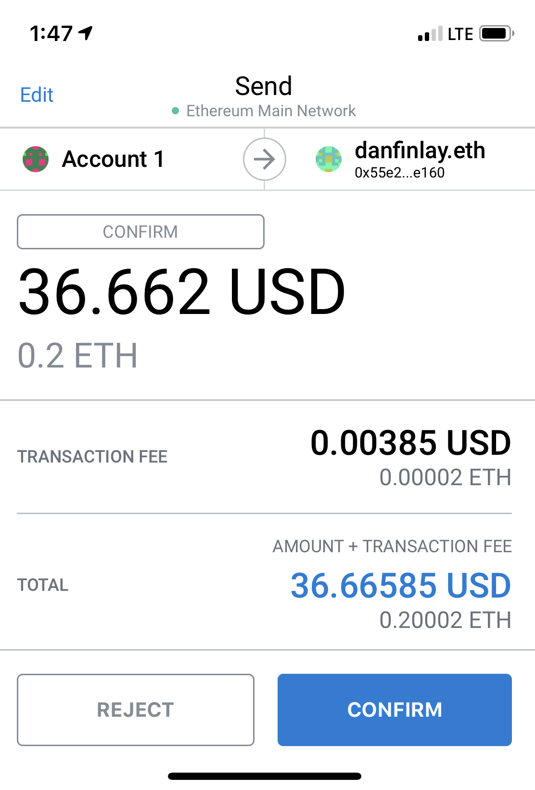
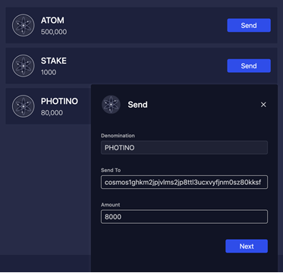
Low-level payments

Slide 4
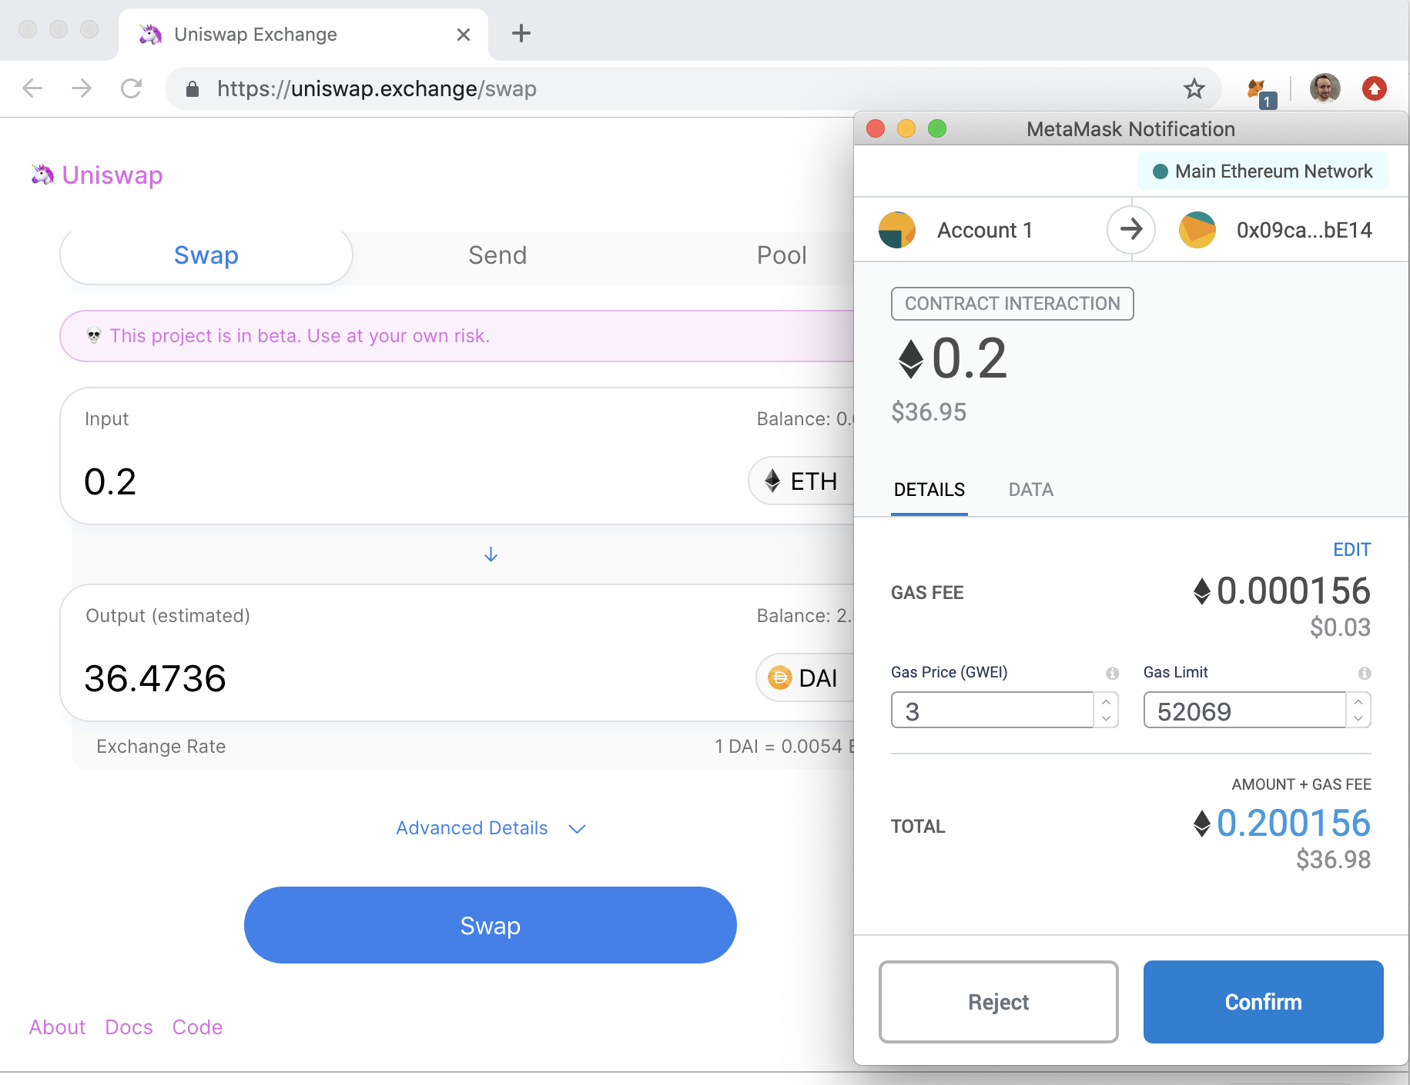
Low-level application UIs

Slide 5
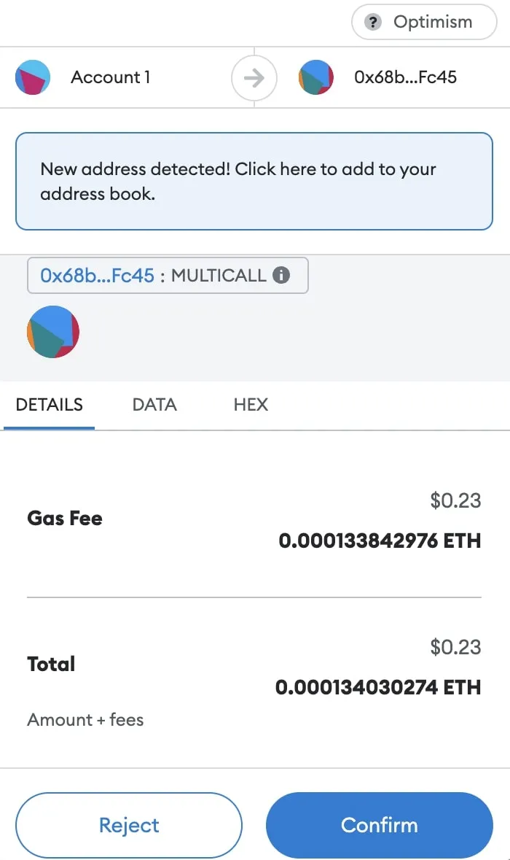
Blinded by the UX
Notes:
If you blind-sign, the exposure is all assets in the wallet

Slide 6
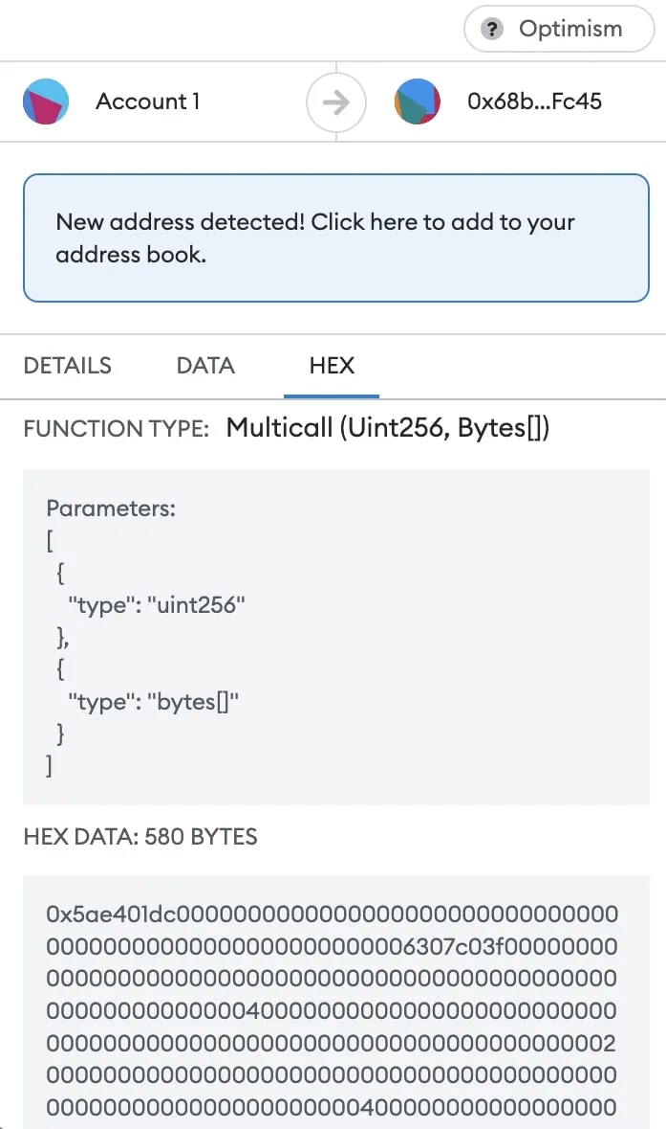
Blinded by the UX
Notes:
If you blind-sign, the exposure is all assets in the wallet

Slide 7
Blinded by the UX
Notes:
If you blind-sign, the exposure is all assets in the wallet

Slide 8
What’s wrong with the UX?!
Unusable for most people
I don’t know anyone named 0x55e2..e160
I can send to the wrong user/contract
Unsafe for everyone
I cannot tell what I’m agreeing to
Contract controls what happens to my funds
Contract shouldn’t need that responsibility

Slide 9
What’s wrong with the UX?!
Unusable for most people
I don’t know anyone named 0x55e2..e160
I can send to the wrong user/contract
Unsafe for everyone
I cannot tell what I’m agreeing to
Contract controls what happens to my funds
Contract shouldn’t need that responsibility
As long as humans are habituated to approving transactions that they cannot understand, they are not protected from endpoint compromise

Slide 10
Offers support
Quid Pro Quo!
Give
0.2 Eth
Want
At least 36.4736 DAI
ExitRule
On demand
After deadline

Slide 11
Offer safety
Proposal contains give and want amounts
Offer contains
Invitation for a specific entry point in a specific contract
Proposal above
Payments
Custom arguments
Offer validation
Proposal has properties required by invitation
Payments match
Provided assets get escrowed asynchronously
JavaScript contract function for the invitation is executed

Slide 12
Swap offer
const giveAmount = ethAmount(0.2);
const givePayment = E(myEth).withdraw(giveAmount);
const wantAmount = daiAmount(36.4736);
const seat = E(zoe).offer(
E(amm).makeSwapInvitation(),
{
give: { In: giveAmount },
want: { Out: wantAmount },
},
{ In: givePayment },
);

Slide 13
Zoe: Offers Everywhere!
Seller auctions Bad Kid #3700, a digital good
Offers bk3700 for at least 600 IST
Clients bid
Offer at most 700 IST for bk3700
Zoe escrows the offered assets
Contract executes
Requests Zoe to reallocate assets among offers
Reallocate must satisfy offer constraints and conservation
Zoe provides payouts
Winnings and refunds

Slide 14
Zoe: Offers Everywhere!
Seller auctions Bad Kid #3700, a digital good
Offers bk3700 for at least 600 IST
Clients bid
Offer at most 700 IST for bk3700
Zoe escrows the offered assets
Contract executes
Requests Zoe to reallocate assets among offers
Reallocate must satisfy offer constraints and conservation
Zoe provides payouts
Winnings and refunds

Slide 15
Offer Safety ensures…
… to clients
Clients receive desired payout or refund
… regardless of the behavior of the contract
… to contracts
Offered assets are synchronously available
Offered assets match their descriptions
Assets will be delivered upon completion

Slide 16
IST Vault Creation
Give
100 ATOM
Want
300 IST
… and a vault

Slide 17
Adjust Vaults
Debt
204 IST
Collateral
100 ATOM
Give
200 IST
Want
20 ATOM
OR
Give
50 ATOM more
Want
300 IST more

Slide 18
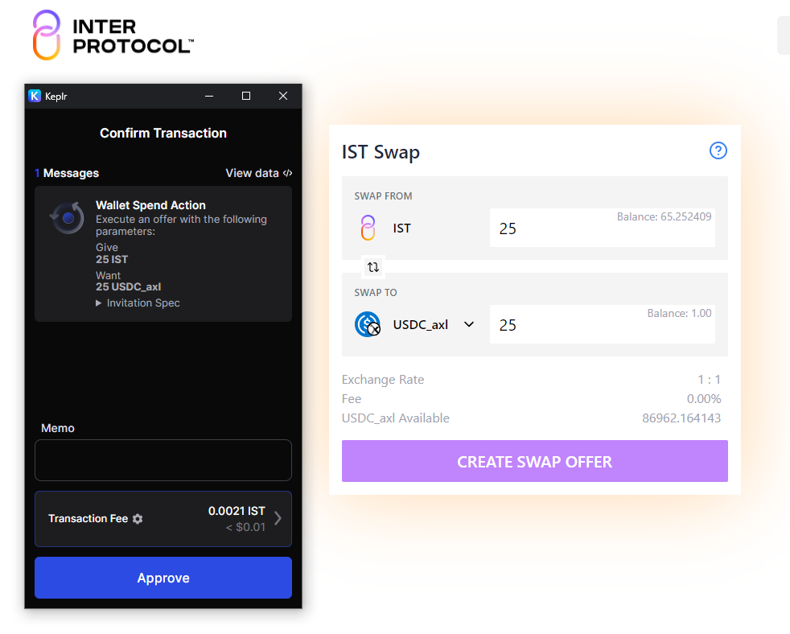
Parity Stability Module trade
const giveUSDC = usdcAmount(25);
const givePayment = E(myUSDC).withdraw(giveUSDC);
const wantIST = istAmount(25);
const seat = E(zoe).offer(
E(psm).makeWantMintedInvitation(),
{
give: { In: giveUSDC },
want: { Out: wantIST },
},
{ In: givePayment },
);

Slide 19
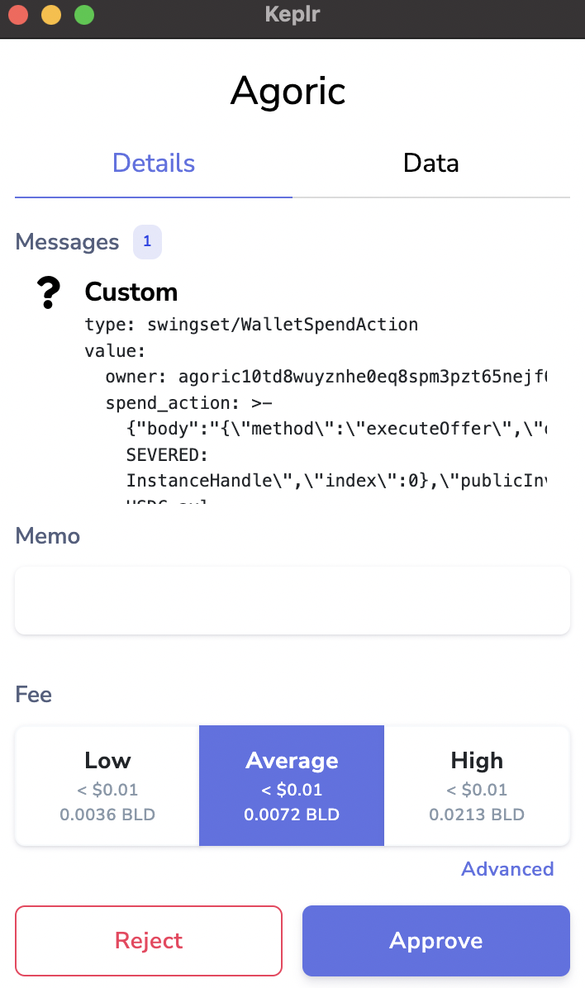
Offer Legibility?

Slide 20
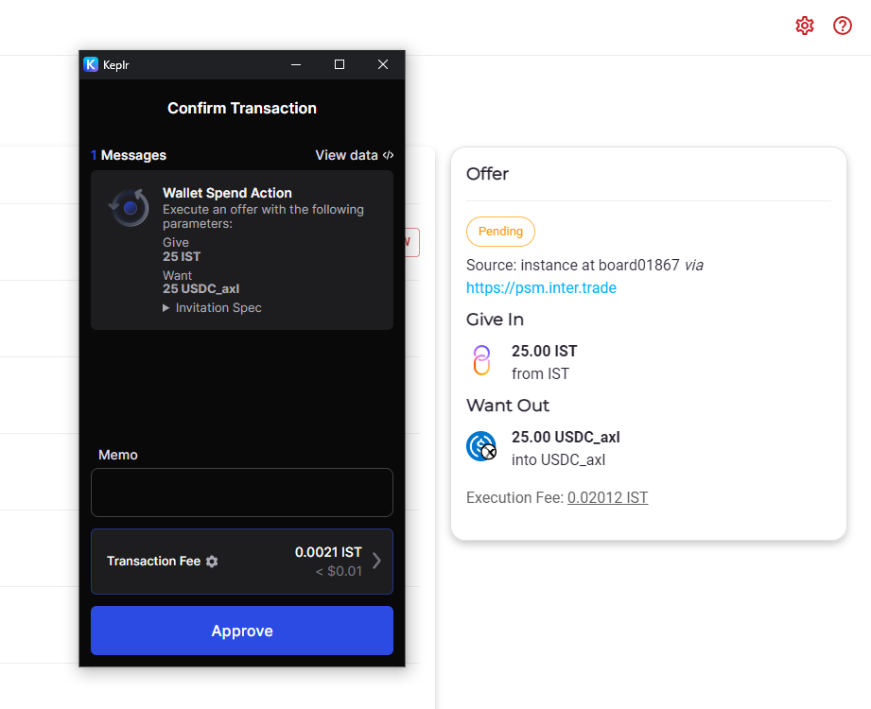
Smart wallet
Account
Abstraction?

Slide 21
Keplr
Offer Legibility!

Slide 22
More
Safety Properties
Payout liveness
Secure partitioning

Slide 23
Extensions
Sign-mode textual
Want patterns
Multiples
Piecewise linear preference curve
Synthetic combined offers

Slide 24
Takeaways
Offers increase usability
Legible to users
Understable limits on approval
Offers increase safety and programmability
Framework provides direct safety properties
Structured offers are extensible

Slide 25
Dean Tribble, CEO
tribble@agoric.om
@DeanTribble
@agoric
agoric.com/discord
agoric.com

