Slide 1
Accountability along the transaction supply chain
Sam Hart
27.08.23

Slide 2
Outline
About Skip
Problem statement
IRL analogy
Accountability framework
Applications

Slide 3
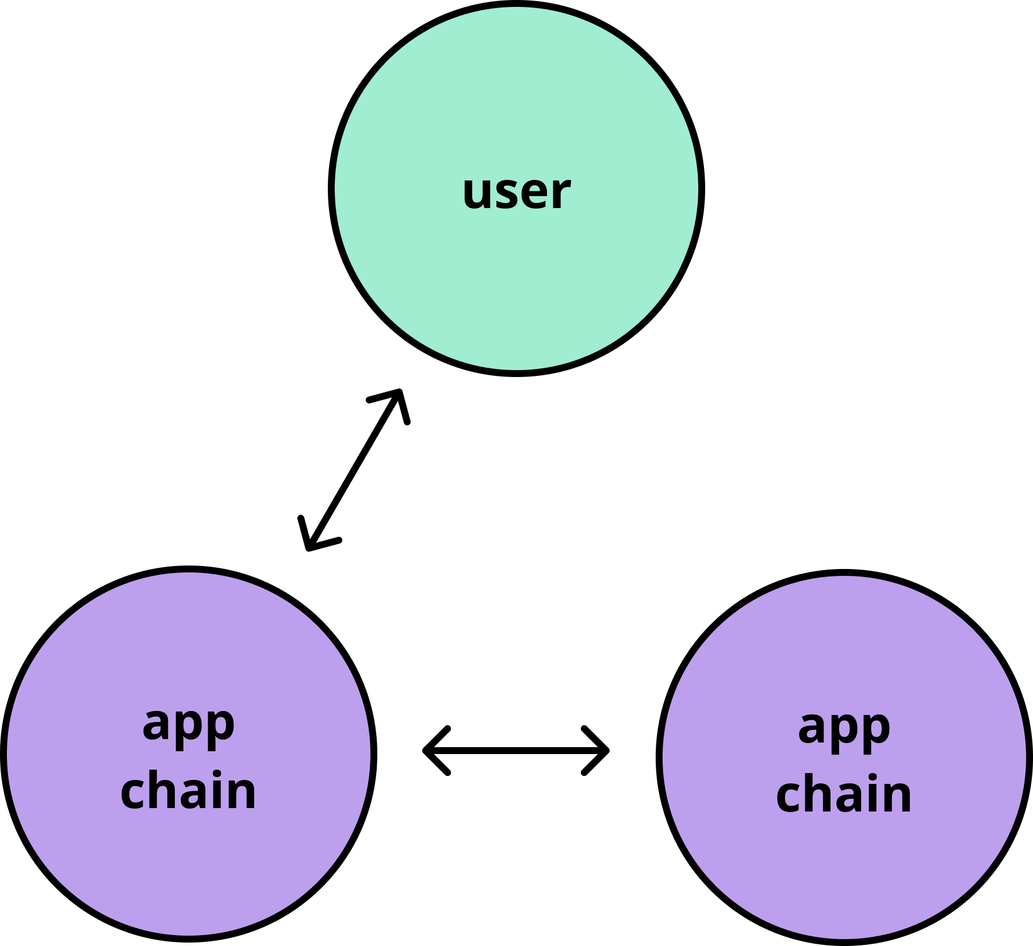
About Skip
MEV + UX solutions for application-specific transaction supply chain
Skip API
Cross-chain routing
DEX aggregation
Block SDK
Lanes
In-consensus oracle
Fee markets
Credible MEV auctions
PEPC-like commitments
Relayer jobs board (soon)

Slide 4
Problem statement
Intents introduce degrees of freedom for solvers to improve efficiency, UX, other conditions of satisfaction
Solver delegation introduces a principal agent problem
Options for alleviating this problem
Reintroduce constraints
Change the information structure
Change the payoff structure
Turn into a repeated game

Slide 5
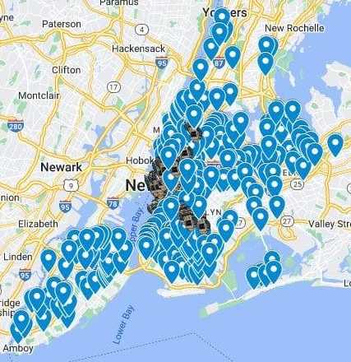
IRL analogy: restaurant industry
The quality of the product + service is relatively good no matter where you eat
Customers have repeat interactions with the establishment
Restaurants rely heavily on reputation to attract business
Restaurants enter intro long-term relationships with service workers
Managerial structure to monitor service
Customers have direct relationship with servers in the form of tips

Slide 6
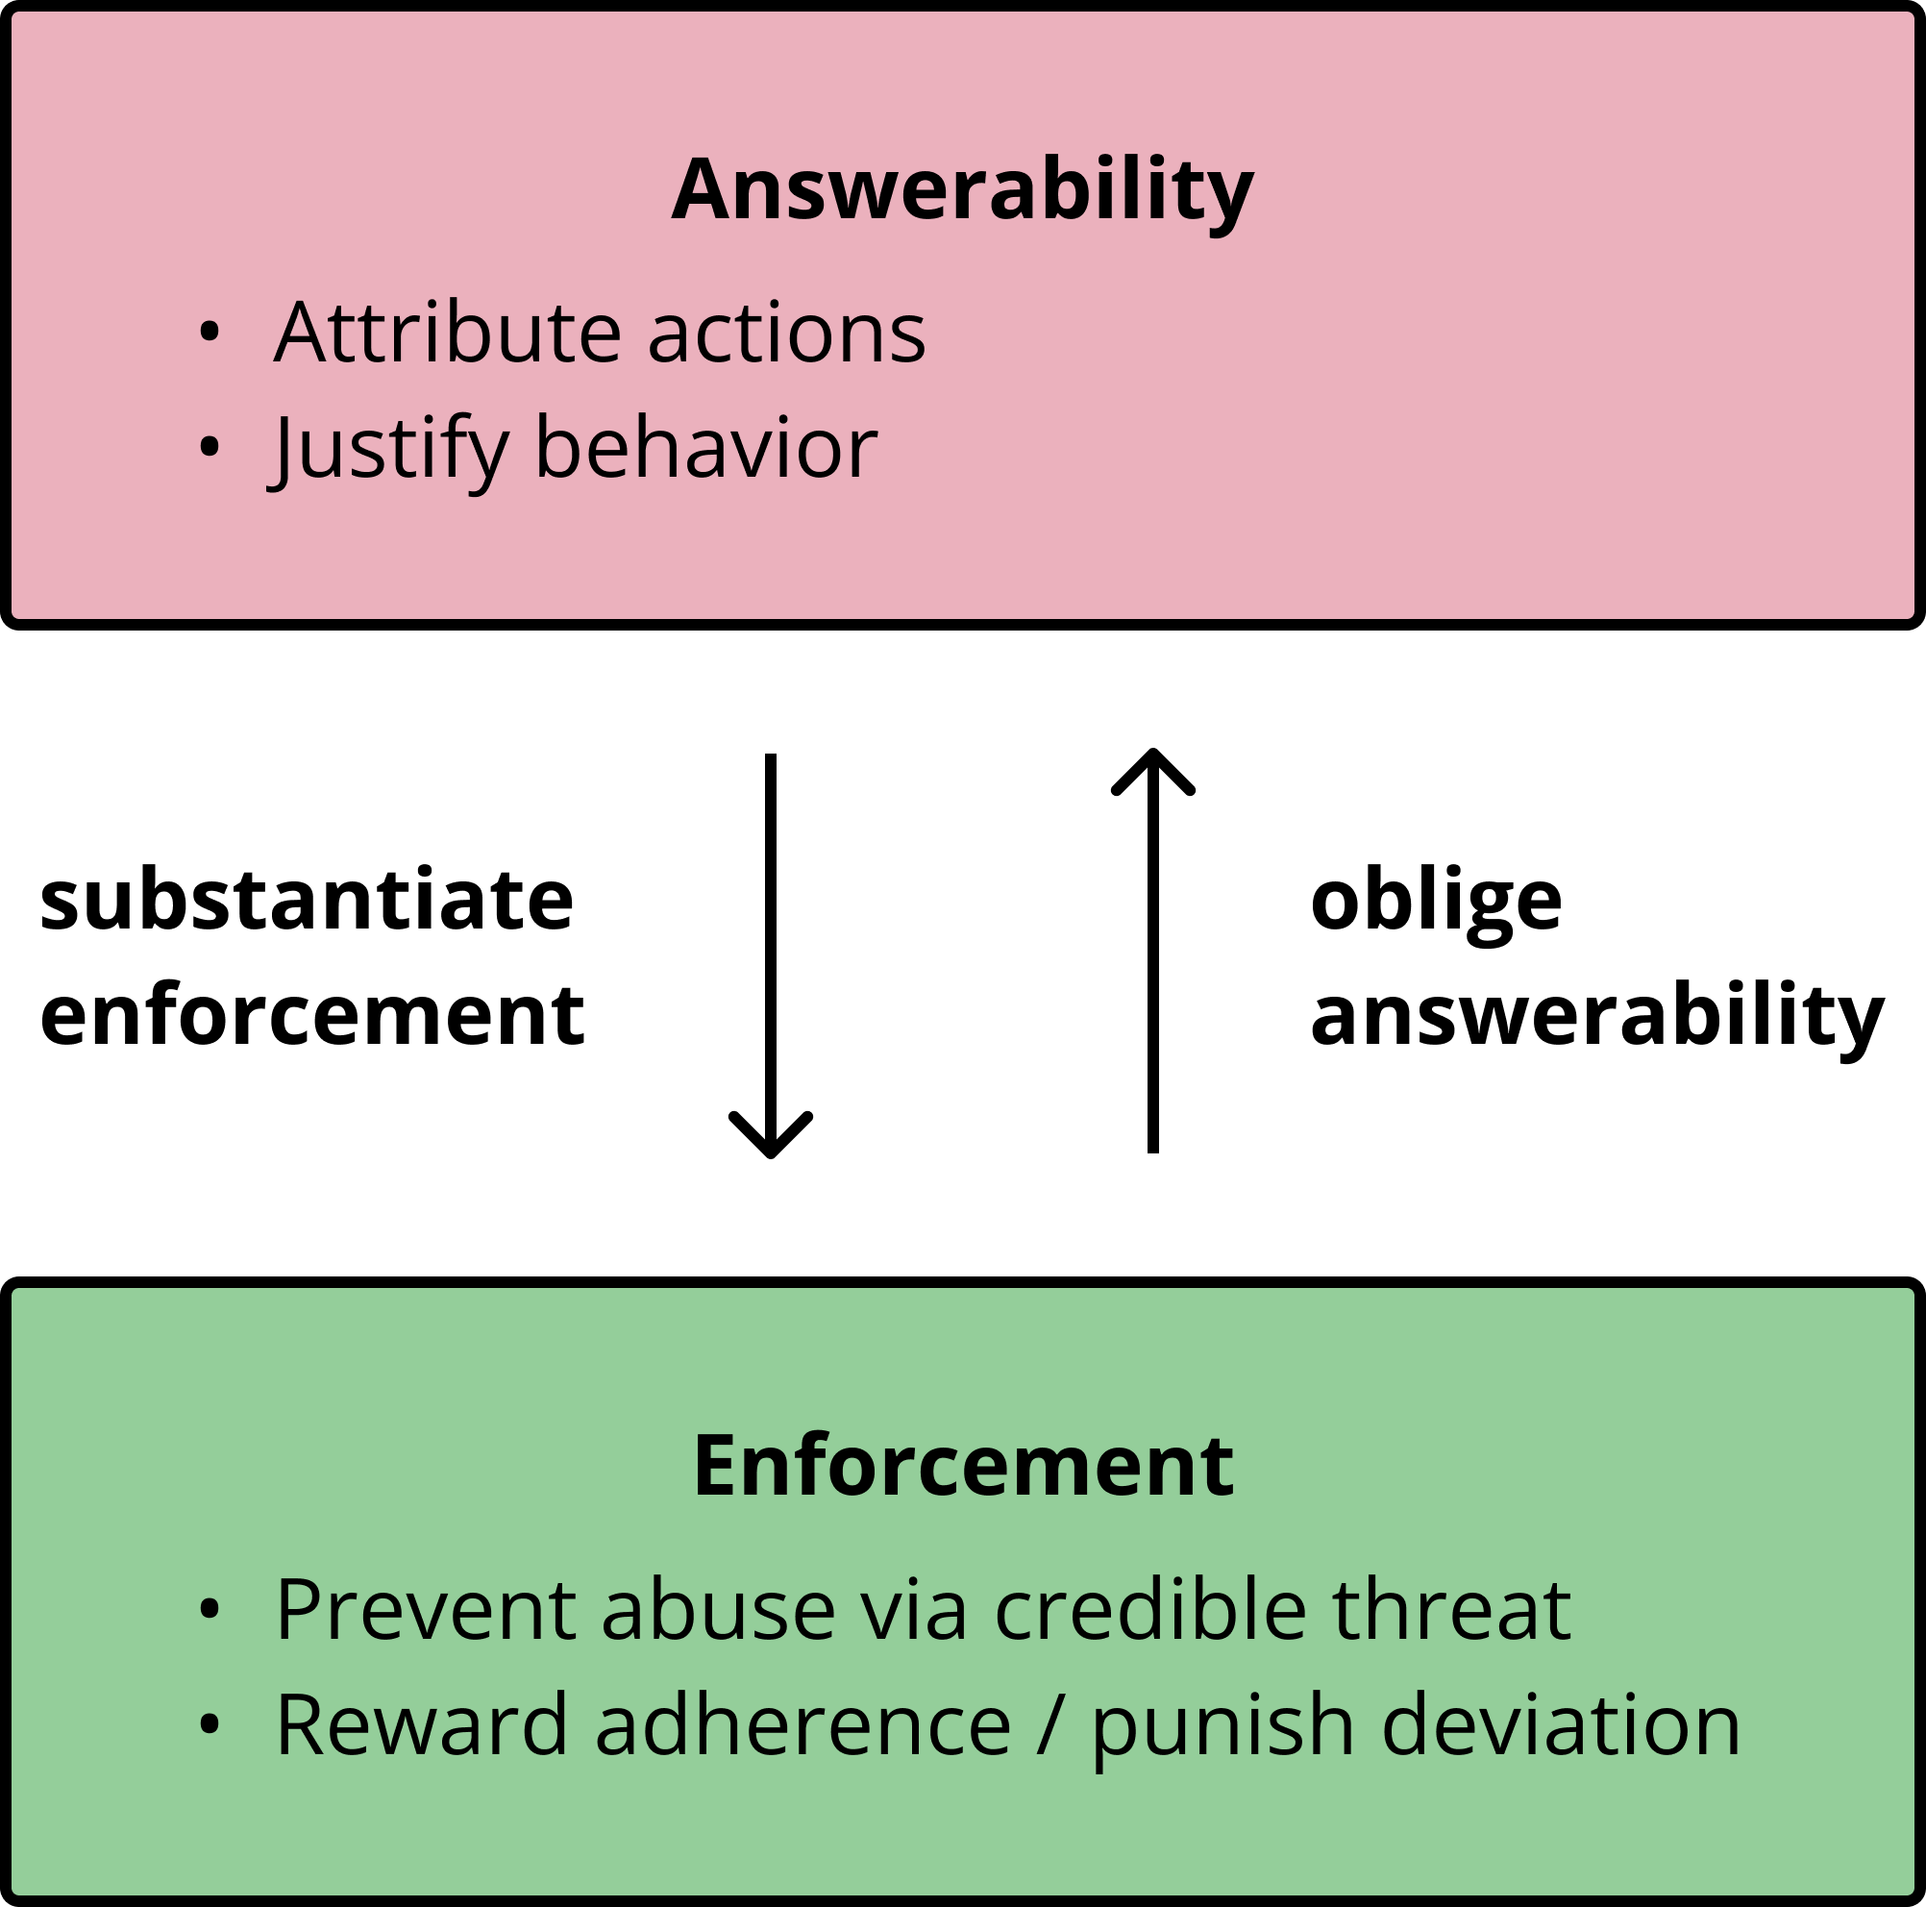
Accountability framework
A is accountable to B when A is obliged to inform B about A's (past or future) actions and decisions, to justify them, and to suffer punishment in the case of eventual misconduct.
Answerability: responsibility to explain or justify behavior
Enforcement: compelling compliance to a set of rules

Slide 7
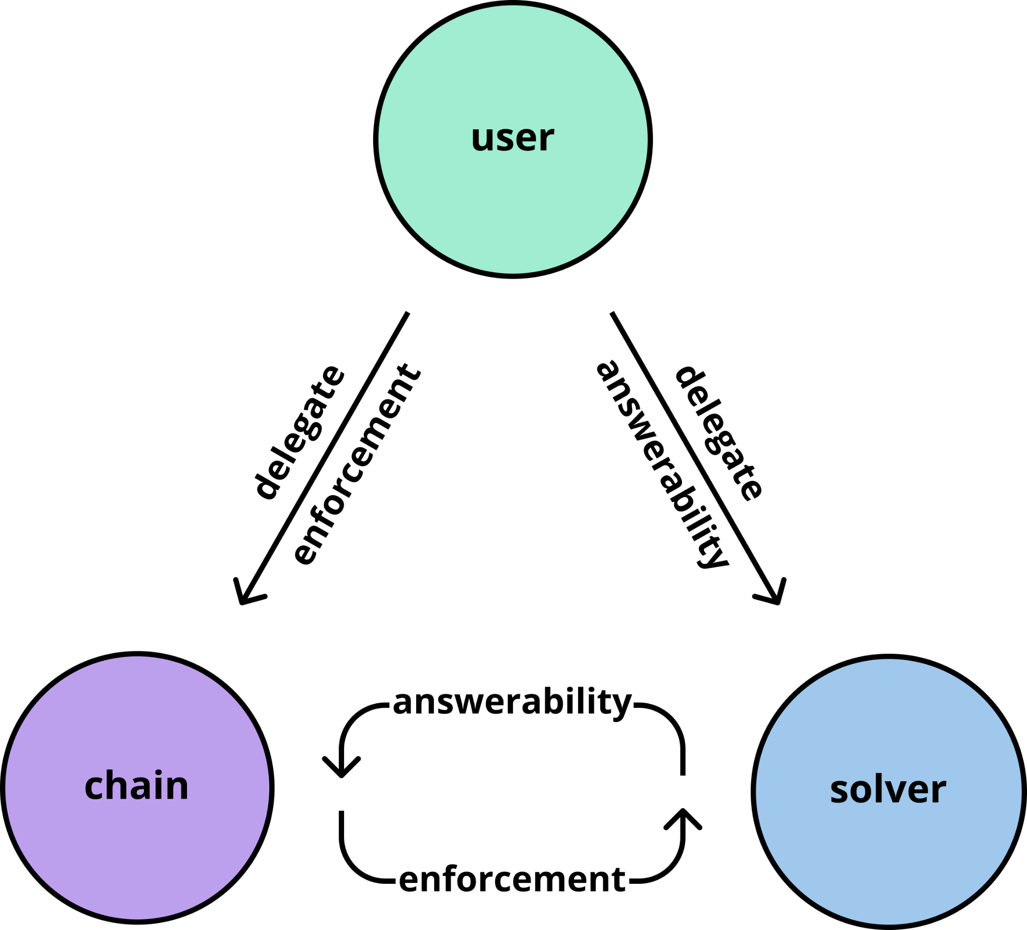
Modeling accountability
A user must employ an accountability system to effectively delegate decision-making
One can alternatively view the protocol as performing a kind of delegation (often how restaurants are understood)

Slide 8
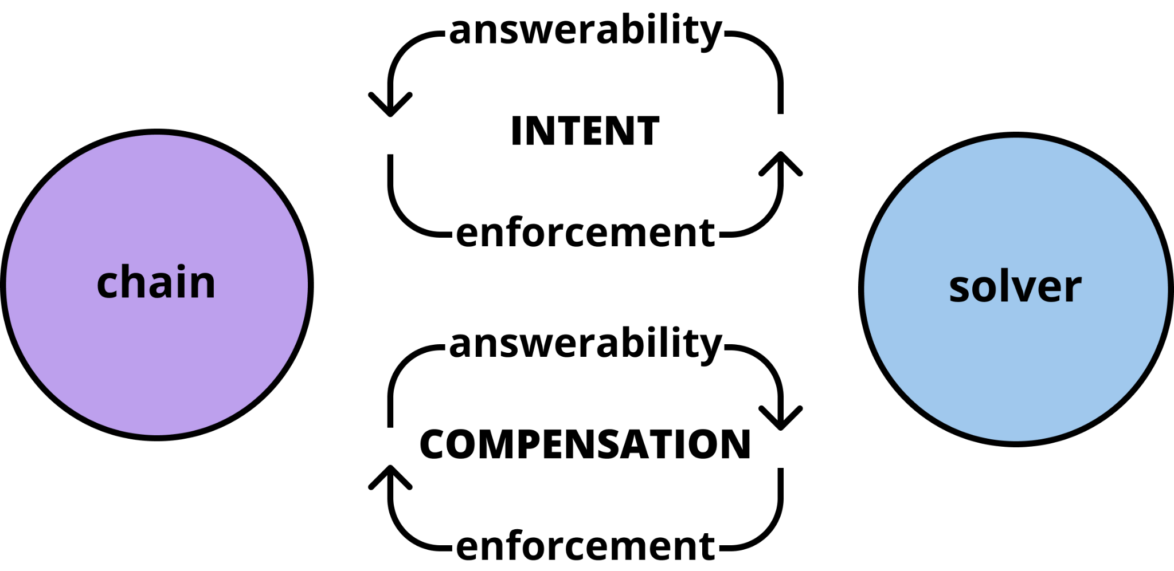
Modeling accountability
Accountability implies entering into a contract with a combination of formal and informal rules
Contracts are two-sided, terms of satisfaction require answerability and enforcement on both sides

Slide 9
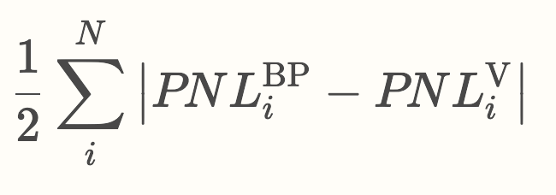
dYdX off-chain orderbook
dYdX has combined mempool + orderbook
Validators expected to correctly gossip + match off-chain orders
Skip runs globally distributed set of nodes to collect copies of the book
Builds “orderbook discrepancy” metric to measure P&L vs expected
Statistical view of behavior provides a basis for answerability

Slide 10
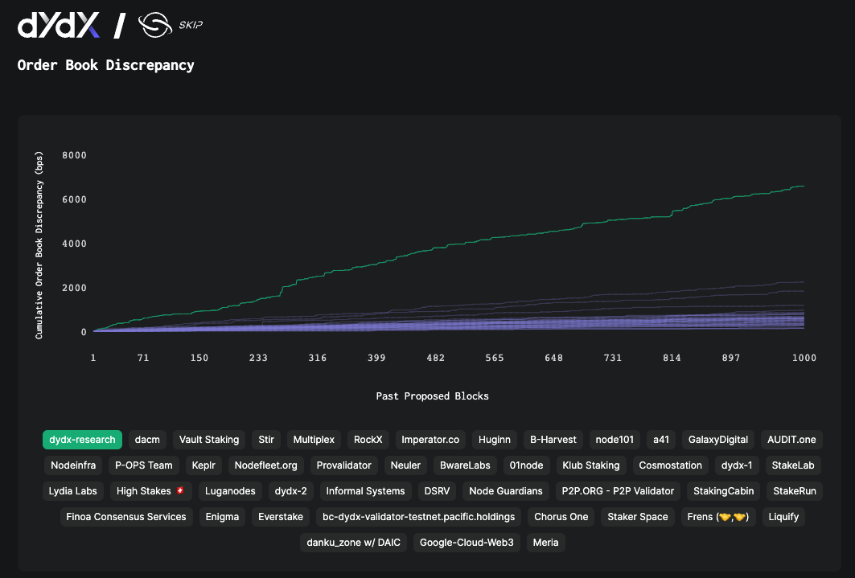

Slide 11
Reputation
Validators in Cosmos are good delegation candidates due to latent reputational network
Incentivized to differentiate via brand identity
Validators have repeated, long-term engagement
Reputation is informally transitive across the network

Slide 12
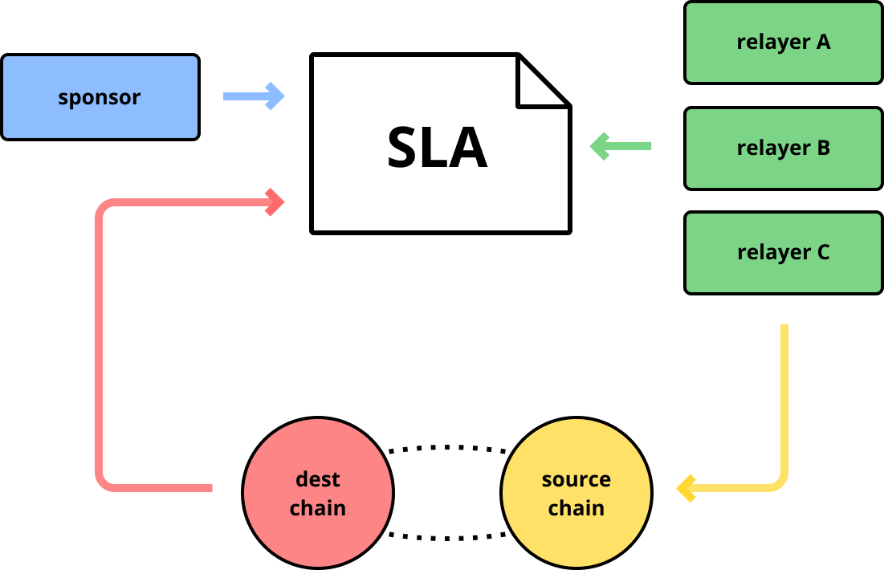
Fixing the IBC relay network
Today IBC relaying occurs via off-chain foundation agreements + as means to advertise delegation
No service metrics, quality is inconsistent
Goal is to make relayers (solvers) put their resources into optimizing for the right things (network robustness + maintaining SLA)

Slide 13
Win-win for users + solvers
Blockspace contention and whole-block building induces monopolistic behavior
→ introduce app-specific blockspace and break the proposer monopoly
Searchers are motivated by profit and stunts
→ create venues that measure and praise alternative behavior
Off-chain actors aren’t playing long-term games
→ leverage repeated interaction and thoughtful use of reputation
Market is focused on value extraction rather than value production
→ introduce accountability structures that allow agents to put resources into optimizing the right things

Slide 14
Thank you
Telegram
@hxrts
Twitter
@hxrts + @SkipProtocol

