Slide 1
Solvers, LSTs, and Memecoins
Sun @ Seven Seas

Slide 2
Background
Seven Seas is a Strategist (Solver) in the Sommelier ecosystem
We develop smart contracts, design and operate strategies, and build dashboards to track performance
$27M (
Notes:
Give a very brief intro to Sommelier

Slide 3
Sommelier architecture
Aave / Compound / Uniswap V3 / Morpho
Rebalance Action
Native Smart Contract on Ethereum
Sommelier Blockchain
Rebalance Message
Rebalance Message
Bridge
Validator Set
Bridged messages, not bridged assets
Rebalance Message
Deposit
Withdraw
Running off-chain computation
Strategy Provider
Users
Seven Seas

Slide 4
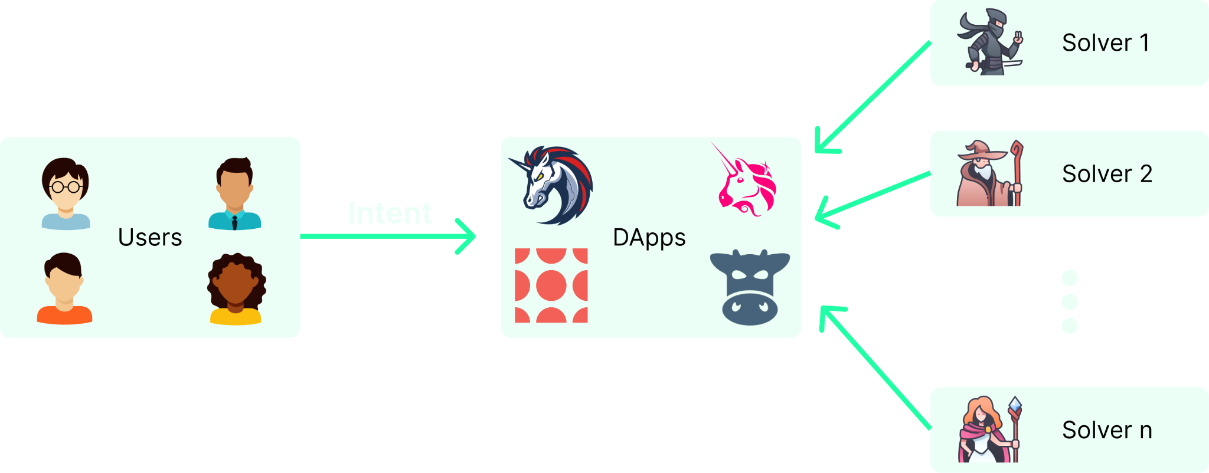
What is a solver?
Catch-all for an actor that leverages off-chain infrastructure to improve on-chain UX
Notes:
Give a very brief intro to Sommelier

Slide 5
Some examples
Market makers
UniswapX
Hashflow
1inch Fusion
0x Relayer
Optimizoors
CoWSwap
Sommelier
Arrakis
Enso
UniswapX
Other
MeV-Boost Relayers
Mev-Share Nodes
Notes:
Give a very brief intro to Sommelier

Slide 6
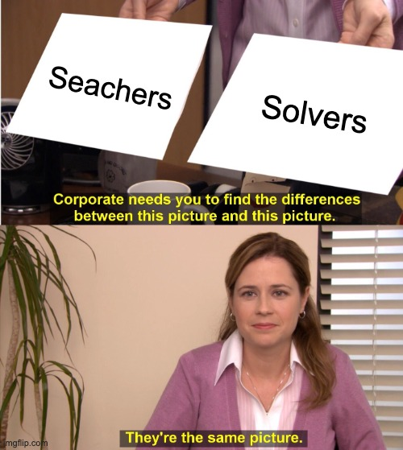
Who are solvers?
Notes:
Give a very brief intro to Sommelier

Slide 7
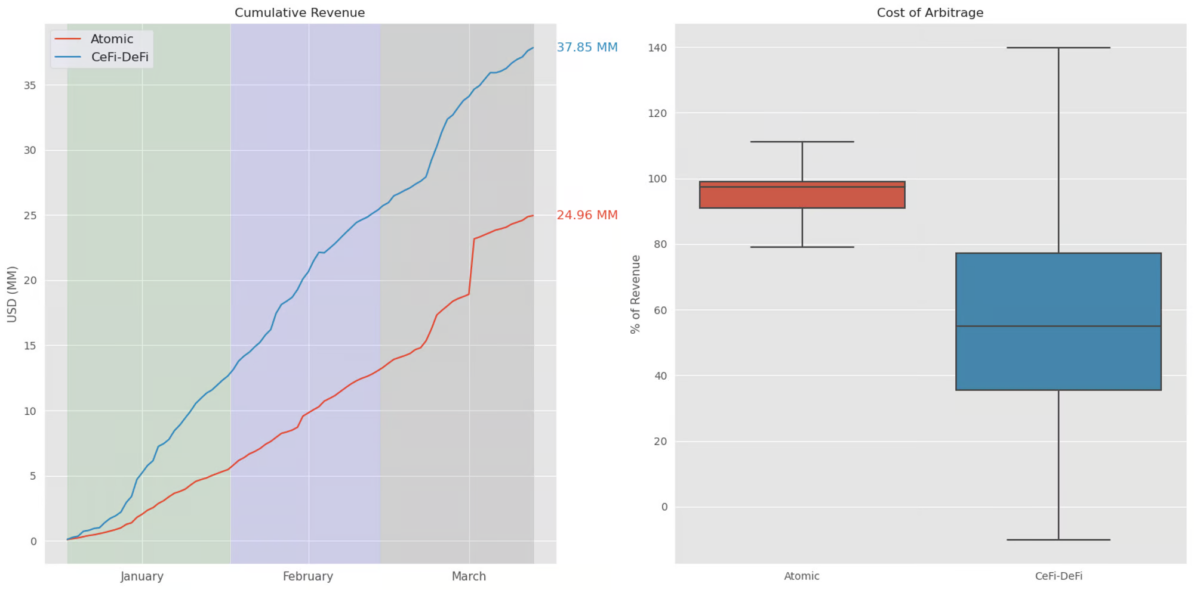
CEX-DEX arbitrage is dominant
60% of arbitrage revenue generated in Q1 2023 was CEX-DEX arbitrage
CEX-DEX arbitragers pay less to validators
Selects for large institutional trading firms
Source: A Tale of Two Arbitrages
Notes:
Give a very brief intro to Sommelier

Slide 8
Intent systems today have the same structure
CEX-DEX dominates RFQ systems today
Direct on-chain routing is at a disadvantage because of increased costs in taking on-chain liquidity
The next wave of DEX innovation is in giving better prices to uninformed flow
Uniswap V4
CoWSwap <> Balancer fee discount
Competing with off-chain liquidity is an uphill battle
Notes:
Give a very brief intro to Sommelier

Slide 9
Is this the whole story?

Slide 10
Two primarily on-chain markets
Source: https://info.uniswap.org/#/pools
Notes:
Give a very brief intro to Sommelier

Slide 11
Memecoins
Most adversarial experience for users
Institutional capital will basically never touch these assets -> solver landscape will remain distributed
Strong case for the existence of AMMs
It’s possible that RFQ systems will capture order flow here as well
Actors who are willing to take inventory risk will have an edge
E.g. jaredfromsubway - infamous sandwich attacker
Notes:
Give a very brief intro to Sommelier

Slide 12
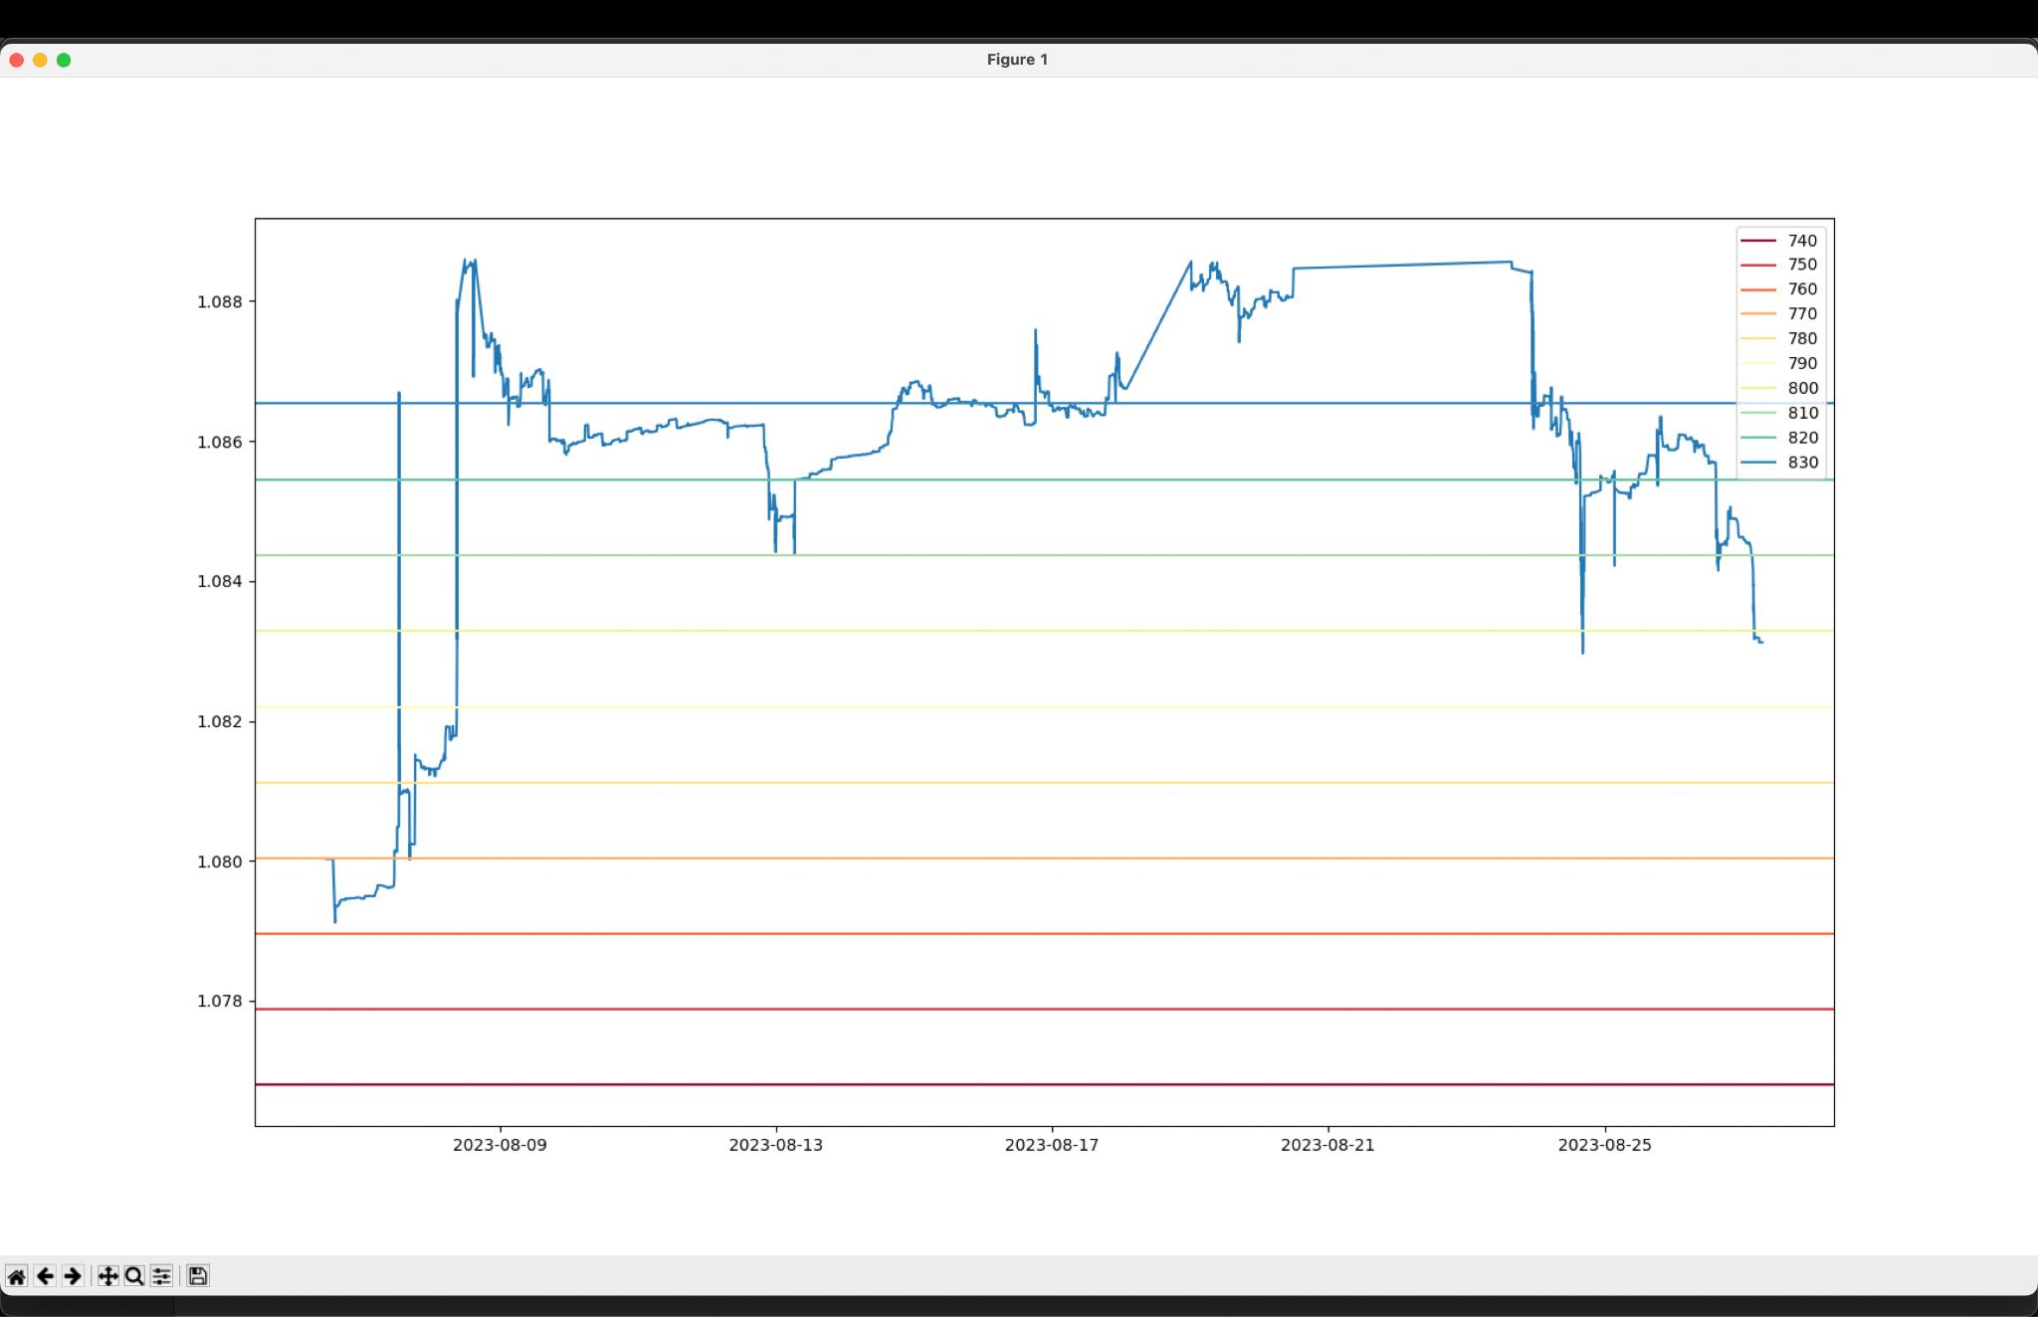
Liquid Staking Tokens (LSTs)
Largest on-chain market
Highly inefficient
Extreme depegs
Mostly passive liquidity in AMMs
Basically 0 liquidity in RFQ systems
Fun fact: Real Yield ETH is the largest market maker for LSTs on Ethereum
Notes:
Give a very brief intro to Sommelier

Slide 13
What can we learn from LST markets?
The solver landscape is still relatively immature
There is a shortage of on-chain infrastructure for solvers
Specialized knowledge of DeFi primitives is an edge
Especially true given the trend of increasing complexity (e.g Uniswap V4)
Notes:
Give a very brief intro to Sommelier

Slide 14
Conclusion
We want to live in a world where primary liquidity is on-chain
Intent systems create the UX to make this possible
On-chain markets are highly inefficient today
There is already significant opportunities for solvers to specialize and profit while being value additive
Notes:
Give a very brief intro to Sommelier

