Slide 1
Completing The Intents Picture
Quintus Kilbourn

Slide 3
Part 1: Intents Letting Go

Slide 4
A Basic Model

Slide 5
A Basic Model
Blockchain: state machine
Has an “operator”
Operator requires “permissions” (messages with signatures) to traverse certain edges

Slide 6
A Basic Model
Blockchain: state machine
Has an “operator”
Operator requires “permissions” (messages with signatures) to traverse certain edges
Agent utility depends on next state of blockchain and of world
world ~= binance price

Slide 7
Permissions Example: Transactions
Transition function map one state and one tx to another state $f(s_1,t_i)\in S$

Slide 8
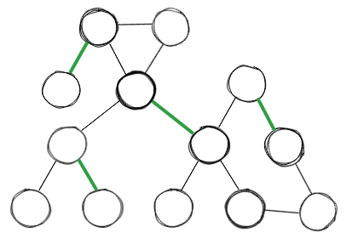
Permissions Example: Transactions
Transition function map one state and one tx to another state $f(s_1,t_i)\in S$

Slide 9
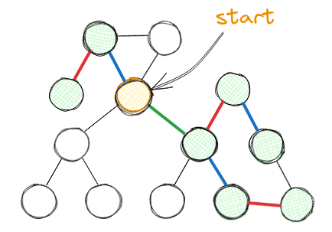
Permissions Example: Transactions
Transition function map one state and one tx to another state $f(s_1,t_i)\in S$
Can combine transactions

Slide 10
Permissions Example: Transactions
Execution
Transition function map one state and one tx to another state $f(s_1,t_i)\in S$
Can combine transactions
Aggregation

Slide 11
Intents: other forms of aggregation

Slide 12
Intents: other forms of aggregation
Chaining doesn’t need to be the only form of aggregation

Slide 13
Intents: other forms of aggregation
Chaining doesn’t need to be the only form of aggregation
Intents loosely: “messages which need not be executable in isolation”

Slide 14
Intents: other forms of aggregation
Chaining doesn’t need to be the only form of aggregation
Intents loosely: “messages which need not be executable in isolation”
=> intents are messages which require aggregation

Slide 15
Why Intents? Why aggregation?

Slide 16
Why Intents? Why aggregation?
Agents’ challenges:

Slide 17
Why Intents? Why aggregation?
Agents’ challenges:
preference elicitation & message space

Slide 18
Why Intents? Why aggregation?
Agents’ challenges:
preference elicitation & message space
fundamental uncertainty (e.g. binance price)

Slide 19
Why Intents? Why aggregation?
Agents’ challenges:
preference elicitation & message space
fundamental uncertainty (e.g. binance price)
strategic uncertainty (what messages will other agents submit?)
adversarial behaviour: what will other players submit given information I reveal?

Slide 20
Why Intents? Why aggregation?
Agents’ challenges:
preference elicitation & message space
fundamental uncertainty (e.g. binance price)
strategic uncertainty (what messages will other agents submit?)
adversarial behaviour: what will other players submit given information I reveal?
technical uncertainty (computationally bounded aggregation)

Slide 21
Why Intents? Why aggregation?
Agents’ challenges:
preference elicitation & message space
fundamental uncertainty (e.g. binance price)
strategic uncertainty (what messages will other agents submit?)
adversarial behaviour: what will other players submit given information I reveal?
technical uncertainty (computationally bounded aggregation)
cost (gas)

Slide 22
Why Intents? Why aggregation?
Agents’ challenges:
preference elicitation & message space
fundamental uncertainty (e.g. binance price)
strategic uncertainty (what messages will other agents submit?)
adversarial behaviour: what will other players submit given information I reveal?
technical uncertainty (computationally bounded aggregation)
cost (gas)
Intents reduce friction for ecosystem of intermediaries

Slide 23
Why Intents? Why aggregation?
Agents’ challenges:
preference elicitation & message space
fundamental uncertainty (e.g. binance price)
strategic uncertainty (what messages will other agents submit?)
adversarial behaviour: what will other players submit given information I reveal?
technical uncertainty (computationally bounded aggregation)
cost (gas)
Intents reduce friction for ecosystem of intermediaries

Slide 24
Why Intents? Why aggregation?
Agents’ challenges:
preference elicitation & message space
fundamental uncertainty (e.g. binance price)
strategic uncertainty (what messages will other agents submit?)
adversarial behaviour: what will other players submit given information I reveal?
technical uncertainty (computationally bounded aggregation)
cost (gas)
Intents reduce friction for ecosystem of intermediaries

Slide 25
Why Intents? Why aggregation?
Agents’ challenges:
preference elicitation & message space
fundamental uncertainty (e.g. binance price)
strategic uncertainty (what messages will other agents submit?)
adversarial behaviour: what will other players submit given information I reveal?
technical uncertainty (computationally bounded aggregation)
cost (gas)
Intents reduce friction for ecosystem of intermediaries

Slide 26
Why Intents? Why aggregation?
Agents’ challenges:
preference elicitation & message space
fundamental uncertainty (e.g. binance price)
strategic uncertainty (what messages will other agents submit?)
adversarial behaviour: what will other players submit given information I reveal?
technical uncertainty (computationally bounded aggregation)
cost (gas)
Intents reduce friction for ecosystem of intermediaries

Slide 27
Why Intents? Why aggregation?
Agents’ challenges:
preference elicitation & message space
fundamental uncertainty (e.g. binance price)
strategic uncertainty (what messages will other agents submit?)
adversarial behaviour: what will other players submit given information I reveal?
technical uncertainty (computationally bounded aggregation)
cost (gas)
Intents reduce friction for ecosystem of intermediaries

Slide 28
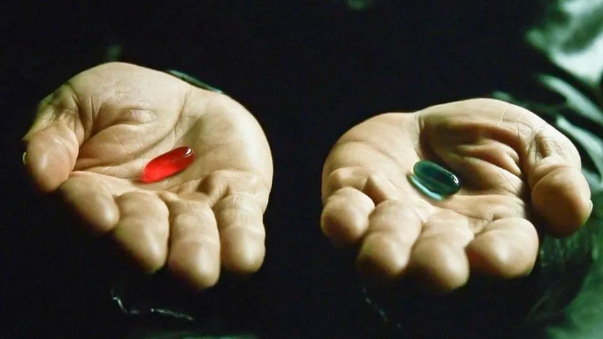
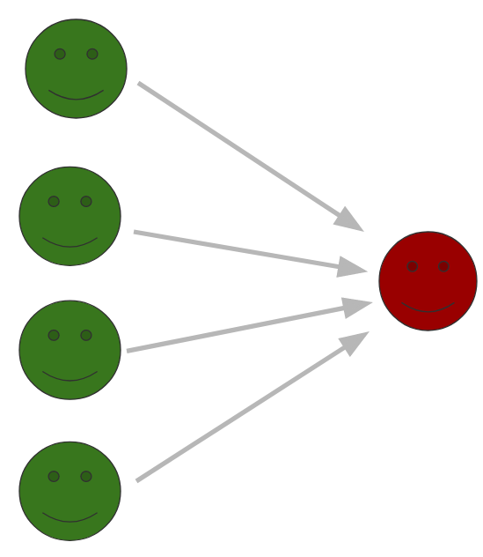
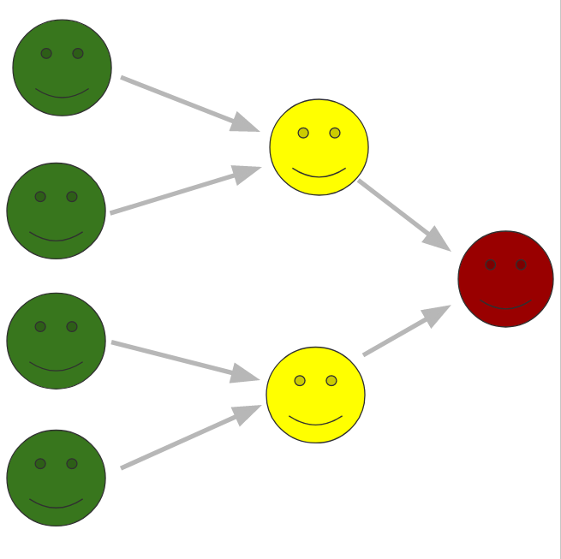

Slide 29
Part 2: MEV Regaining Control

Slide 30
The Problem: Abuse of Freedom
Restricting The Intermediary (Avoiding Relying on Trust)
Integrity
for a given output, there exists a valid input
e.g. avoid disaggregation (unbundling)
e.g. avoid incorrect transition function (rollup)
Provision of information
correct input
e.g. avoid censorship of other orders in batch/fills in RFQ
e.g. provide up-to-date oracle info
Privacy
use of input/ouput restricted to intended computation
e.g. avoid frontrunning

Slide 32
Challenges to Maintaining The Balance
Latency overhead reintroduces uncertainty
e.g. proof computation time
e.g. DA consensus block time
e.g. TEE overhead
Too much privacy kills counterparty discovery
e.g. can’t have fully private OFA
DoS risk for intermediary
e.g. can’t attempt compute on arbitrary encrypted data
need certainty that it pays to execute the message

Slide 33
THE END!
Things I didn’t cover:
examples of intermediaries we see today
why reliance on trust in intermediaries is bad (somewhat obvious)
how flashbots is thinking about these issues

